Slide 1
Lesser Toe Deformity
&
Plantar Plate Repair
北京同仁医院足踝外科
王智
2011-9-28

Slide 2
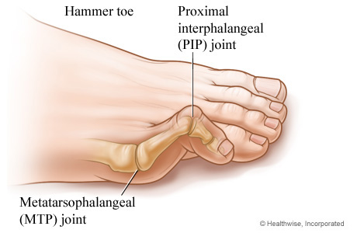
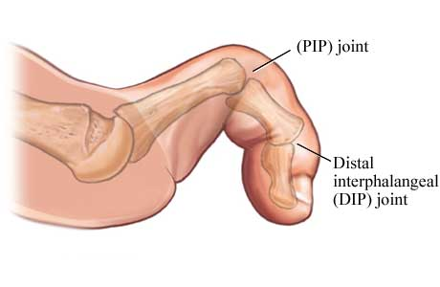
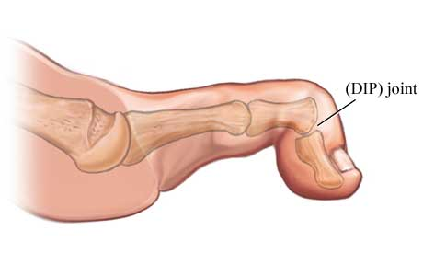
Definition
Hammer toe, Claw toe, Mallet toe
 | Hammer | Claw | Mallet
MTP | Extended | Extended | Neutral
PIP | Flexed | Flexed | Neutral
DIP | Extended | Flexed | Flexed

Slide 3

Metatarsaophalangeal(MTP) joint Instability
Weakening of passive joint restraints:
  Plantar fascia
  Plantar plate
  Collateral ligaments
Coronal: Collateral ligament
+
Sagittal: Plantar plate
Both (Crossover toe)
Most Prevalent

Slide 4
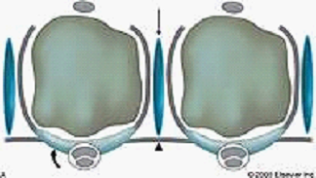
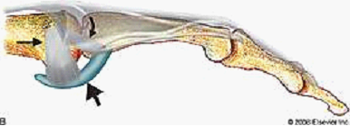
Plantar plate
Deep transverse intermetatarsal ligament
Intermetatarsal bursae
accessory collateral ligaments
phalangeal collateral ligaments

Slide 5
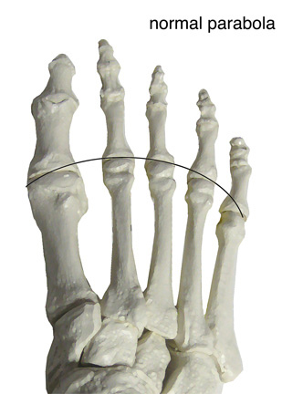
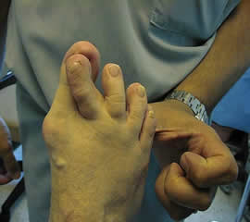
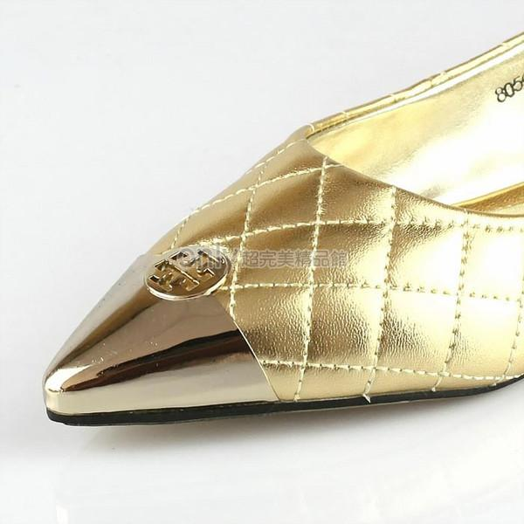
Instability
Hallux valgus: overload of 2nd MTP
Metatarsal parabola: Long 2nd or 3rd metatarsal
Poor fitting shoes: tight toe box

Slide 6
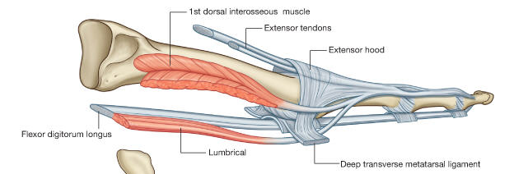
Muscle Balance
Extrinsic and intrinsic muscles:
Intrinsic muscle fails
Neuromuscular disease(CMT, Neuropathy)
Pressure
EDL/EDB
Intrinsics
Intrinsics
FDL/FDB

Slide 7
Clinical Presentation
Pain
Fixed or flexible?
MTP Joint instability
Lesser toe diformity
Tight heel cord
Hallux valgus
Short 1st metatarsal

Slide 8
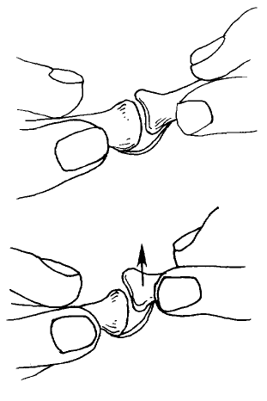
Lachman’s Test
Demonstrate instability of MTP joint:
Drawer sign
Dorsally sublux the joint
Positive: 2mm, 50%
False (+):
insufficient
  Plantar plate
  Collateral ligament

Slide 9
Kelikian Push Test
Push the MTP joint:
Medially deviation of toe
Pain
Plantar plate injury

Slide 10
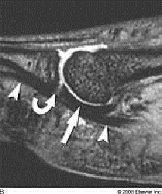
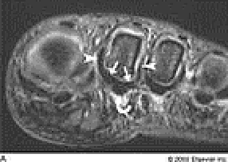
normal plantar plate
plantar plate rupture (curved arrow)
plantar plate rupture

Slide 11
Differential Diagnosis
Interdigital neuralgia
Metatarsalgia
IPK, Intractable Plantar Keratoses
(难治性胼胝症)
Friedberg disease

Slide 12

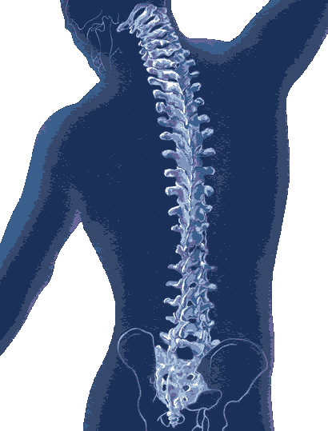
Simple Algorithm of Corretion of Lesser Toe Deformity
Fixed or Flexible?

Slide 13
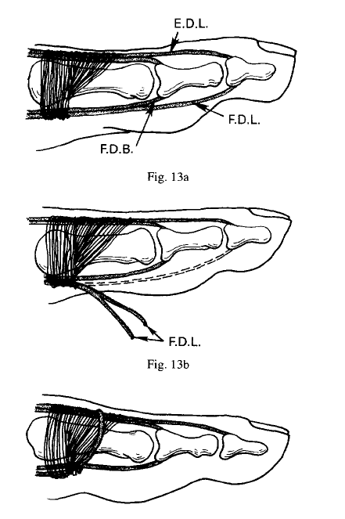
Treatment
Flexible Hammer toe:
  Girdlestone-Taylor procedure
  Extensor tendon lengtening

Slide 14
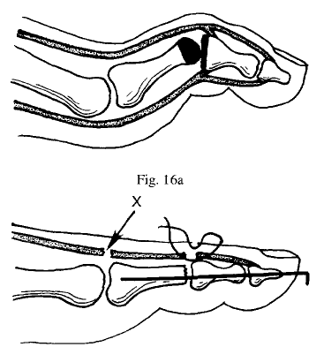
Treatment
Fixed Hammer toe:
  Resection arthroplasty of PIP joint (DuVries)
  Release FDL
  Z-lenthening Extensors

Slide 15

Treatment
Plantar plate repair
  How?
Techniques in Foot & Ankle Surgery Volume 10, Number 1, March 2011

Slide 16
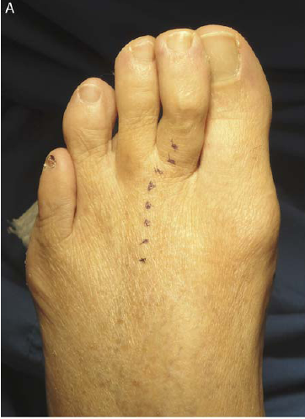
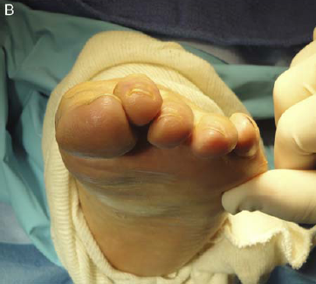
Plantar plate rupture

Slide 17
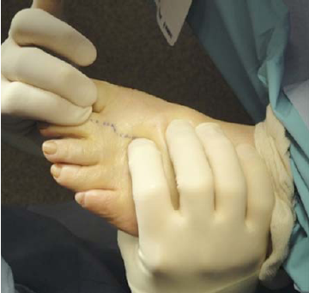
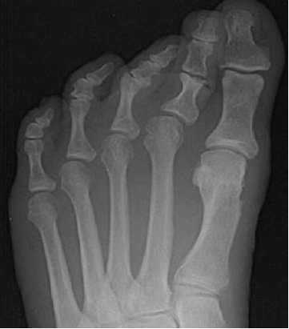
Drawer sign (+)

Slide 18
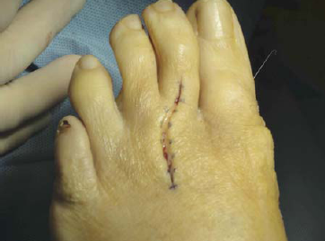
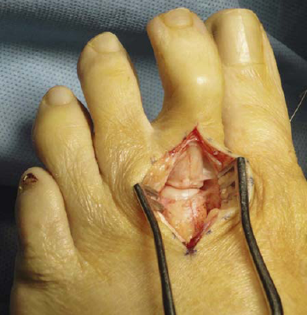
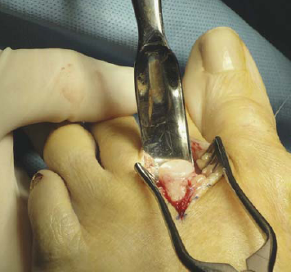
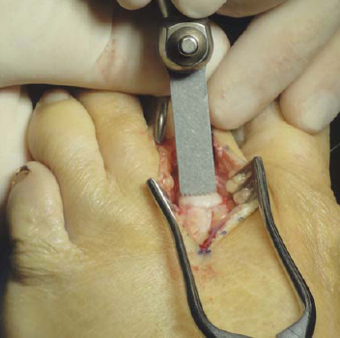
1. Curvilinear incision
2. Secured between the
extensor tendons
3.McGlamry elevator
4. Weil metatarsal osteotomy

Slide 19
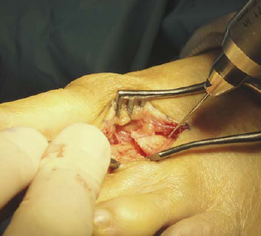
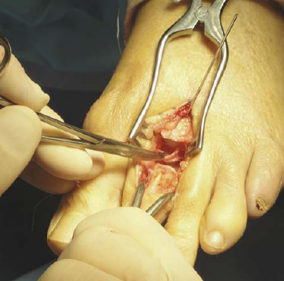
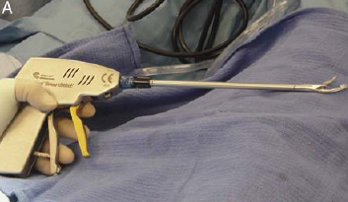
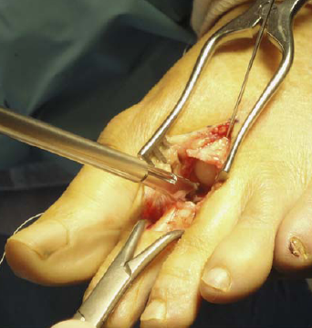
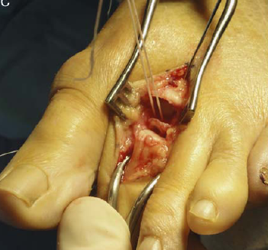
5. Retrograded and pinning
6. base of the proximal phalanx
distracted distally
7. Opus Smart Stitch System
8. plantar plate is grasped proximally and a nonabsorbable suture is used to create a mattress stitch.

Slide 20
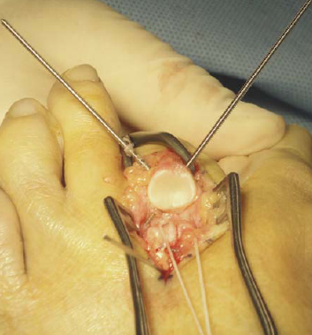
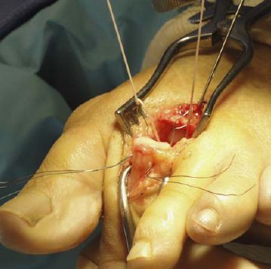
9. base of the proximal phalanx
10. engaging the plantar plate onto the base of the proximal phalanx

Slide 21
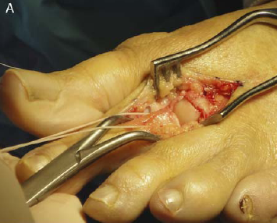
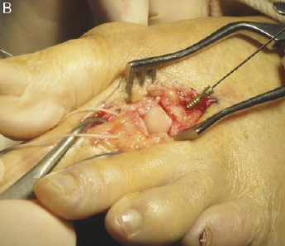
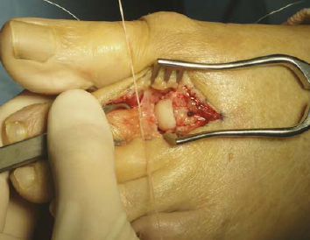
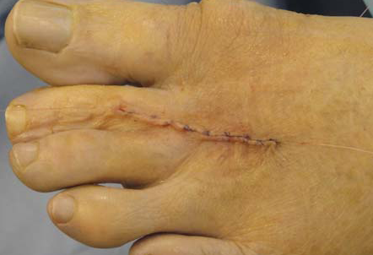
11. Weil: aligned to anatomic contour, and fixated with a 2.5mm threaded head screw
12. tied dorsally with the digit firmly
13. Closed in layers

Slide 22
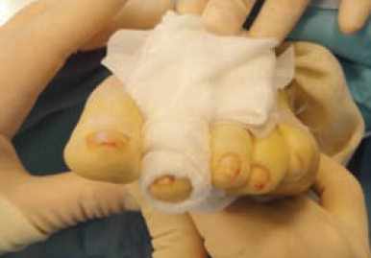
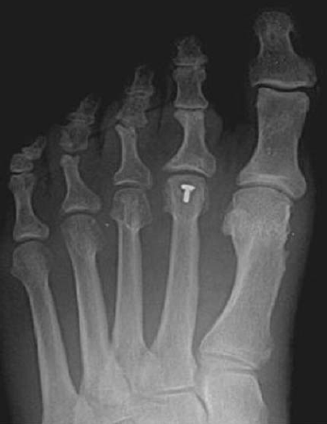
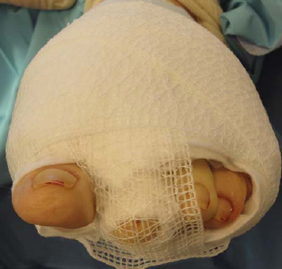

Slide 23
Result
13 (15 feet) by a single surgeon
22.5 months (range 13 to 33 months)
American Orthopaedic Foot and Ankle Society Lesser Metatarsophalangeal– Interphalangeal Scale = 85.7
VAS: 7.3 1.7
NO “floating toe”
Complications:
Painful hardware (3 cases)
Metatarsalgia (1 case)

Slide 24
Score
AOFAS Metatarsophalangeal-Interphalangeal Scale (100 Points)
Pain(40%) | None(40), Mild (30), Moderate (20), Severe (0)
Function(45%) | Activity Limitations: No(10), Limitated(7), Moderate(4), Severe(0)
 | Footwear: All (10), Comfort only (5), Specific(0)
 | MTP Motion: Normal (10), Restricted(5), Severe (0)
 | IP Joint : Normal(5), Restricted (0)
 | Joint Stability: Stable(5), Unstable(0)
 | Callus: No (5), Symptomatic (0)
Alignment(15%) | Good(15), Fair (8), Poor (0)

Slide 25
Discussion
Weil osteotomy: reduced MTP subluxation
2 tendon transfer procedure
  Haddad, Foot Ankle Int. 1999;20:781-788
MTP joint capsule anatomic repaire: 15 patients
  Powless and Elze, J Foot Ankle Surg. 2001;40:374-389
Tendon transfer: flexor to extensor
  Myerson and Jung, 22 of 59 recurrent deformity
Plantar repaire versus flexor to extensor
  Ford, J Foot Ankle Surg. 1998;37:217-222
77% Satisfied
Address the problem
37% Recurrent & 42% Satisfied
No Differences

Slide 26

Thank You

Slide 27
Thank You

